Slide 1


SEM - III : MINI PROJECT

Slide 2

SEM - III : MINI PROJECT
REVERSE CAR PARKING SYSTEM
USING IC LM358

Slide 3
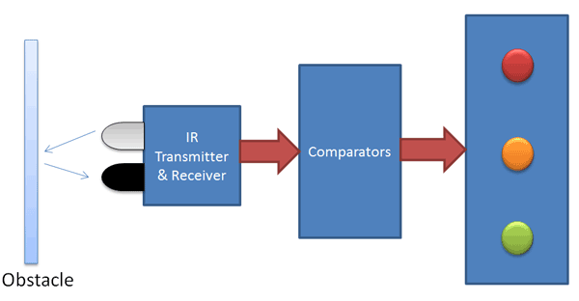
PROJECT BY :
Paresh Meher
19104B0053
Gaurav Kanojia
19104B0053
Gaurav Gupta
19104B0043
Dhiraj Mantri
19104B0052

Slide 4
Litrature Survey

Slide 5


Most Common Difficulties while Reverse Parking the Car

Slide 6
But what if you have a Circuit that indicates you how far is the object with the help of LED and sesnsor.

Slide 7
System Development

Slide 8
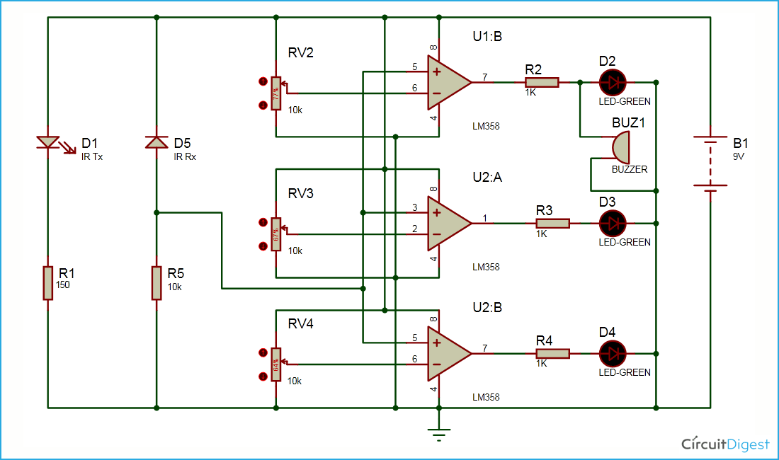
Circuit Design

Slide 9
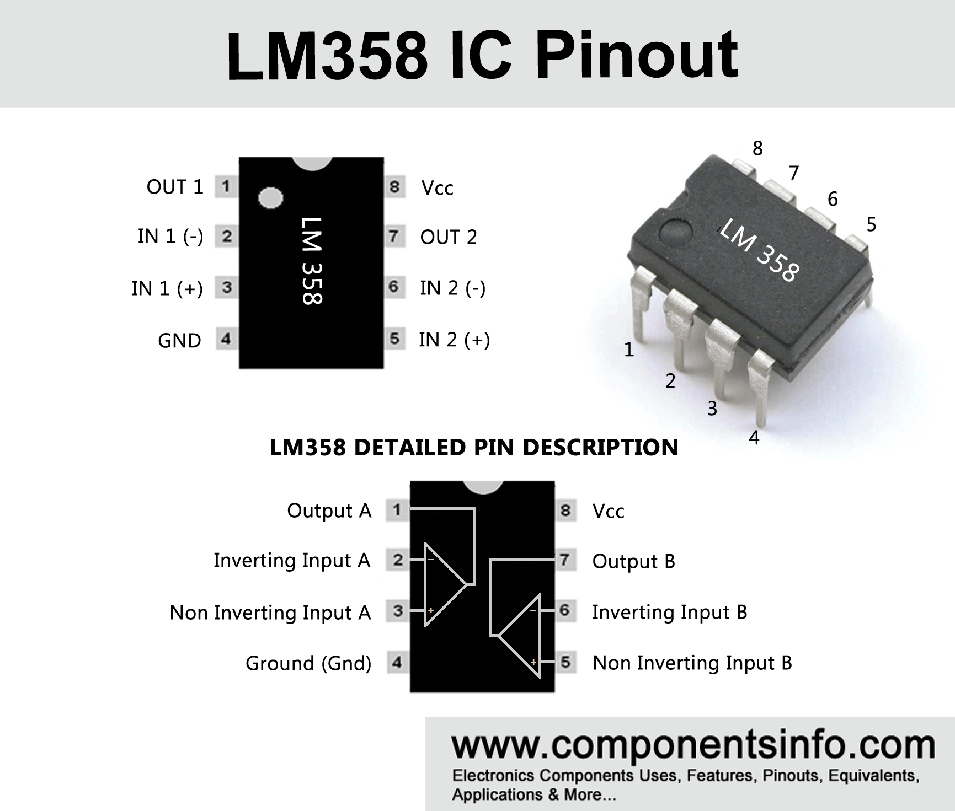
OP-Amp IC LM358
•The LM358 IC is a great, low power and easy to use dual channel op-amp IC. It is designed and introduced by national semiconductor. It consists of two internally frequency compensated, high gain, independent op-amps. This IC is designed for specially to operate from a single power supply over a wide range of voltages. The LM358 IC is available in a chip sized package and applications of this o-pamp includes conventional op-amp circuits, DC gain blocks and transducer amplifiers. LM358 IC is a good, standard operational amplifier and it is suitable for your needs. It can handle 3-32V DC supply and source up to 20mA per channel. This op-amp is apt, if you want to operate two separate op-amps for a single power supply. It’s available in an 8-pin DIP package .

Slide 10
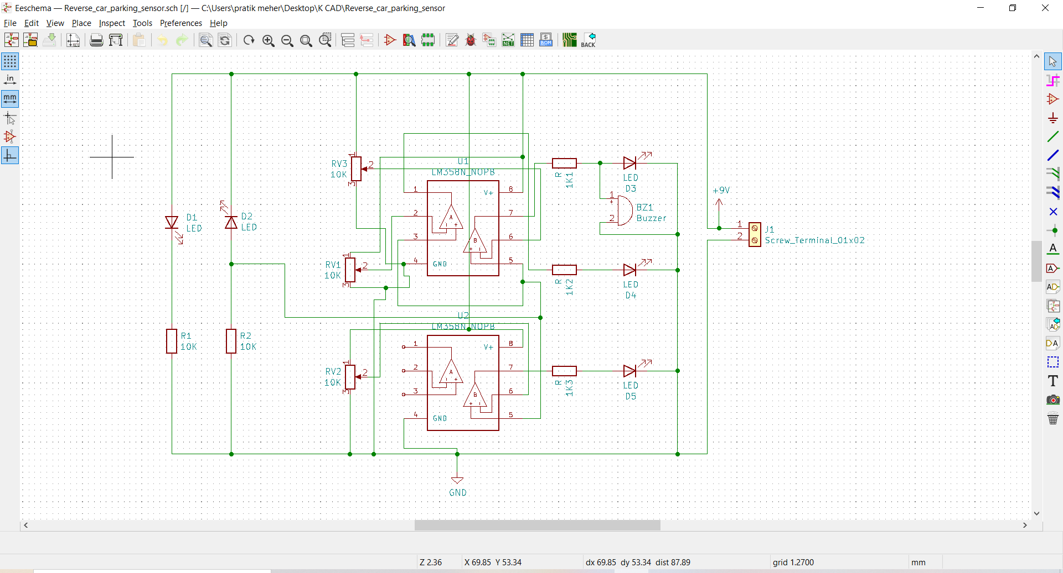
Schematic

Slide 11
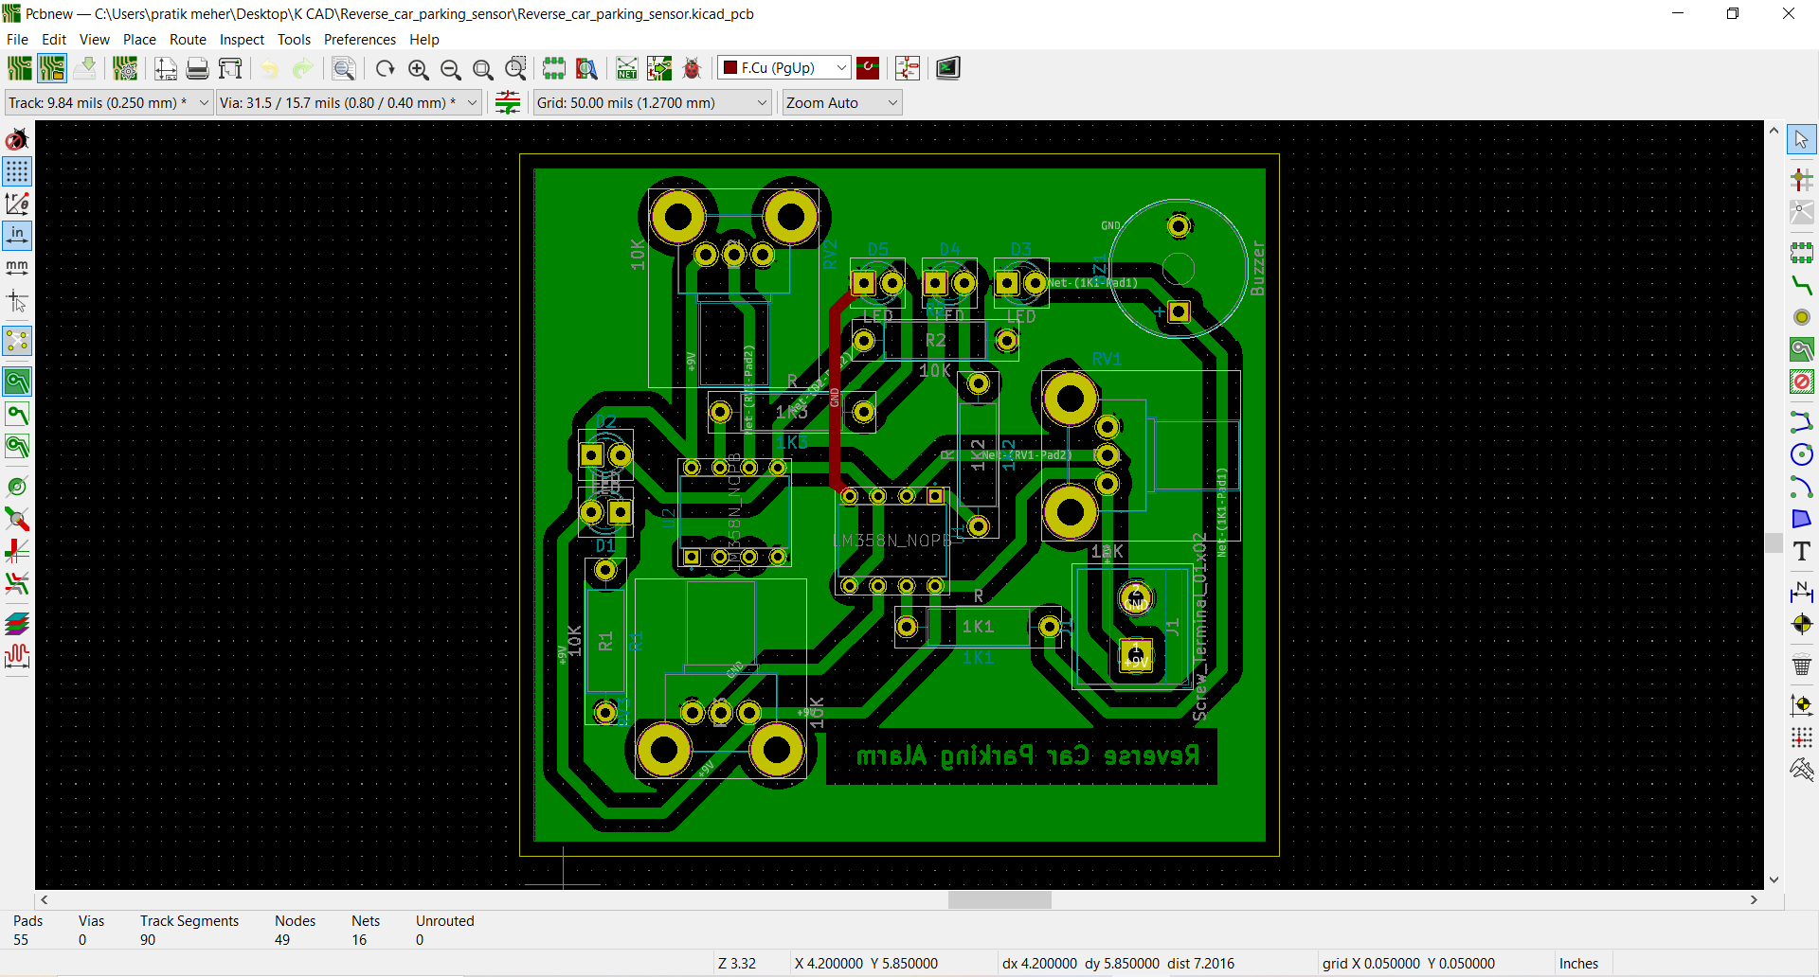
PCB Design

Slide 12
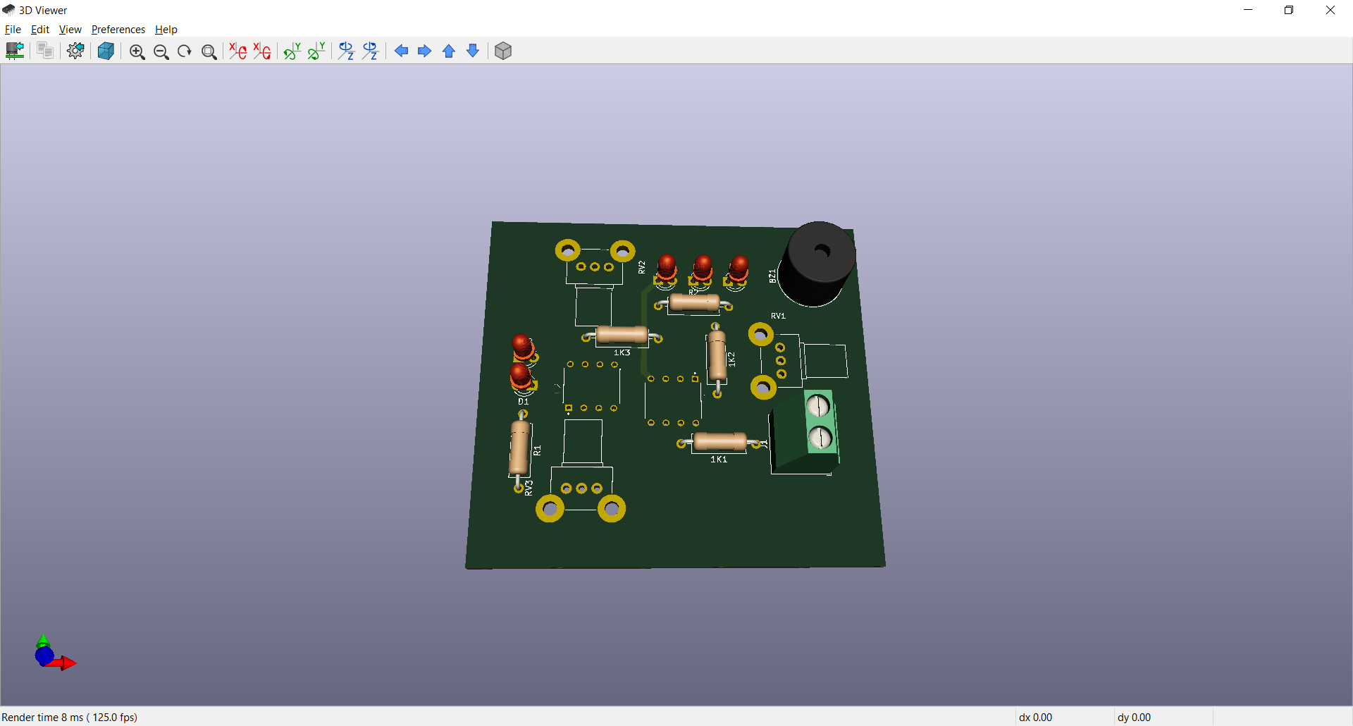
3
D View

Slide 13
The circuit helps to park the car easily and efficiently. The circuit consists of buzzer that beeps when the object is very close to the car. This avoid contact of the car and object which in turn saves the car from getting damaged.
We have studied the working of all the components. We have performed the simulation of the circuit using this software to check the virtual verification of our project.
CONCLUSION

Slide 14
ACKNOWLEDGEMENT
We take this opportunity to express our profound gratitude and deep regards to our guide Prof. Mayur Kumar Nanda for his exemplary guidance, monitoring and constant encouragement throughout the course of this project work.
We also take this opportunity to express a deep sense of gratitude to
Dr. Sanjay Singh Thakur, HOD of E.X.T.C. Dept. for his cordial support, valuable information and guidance, which helped us in completing this task through various stages.
We are obliged to staff members of Vidyalankar Institute of Technology, for the valuable information provided by them in their respective fields. We are grateful for their cooperation during the period of our project work.
Lastly, we thank almighty, our parents, our family and friends for their constant encouragement.

Slide 15

Thank
you!

